Slide 1

Payout Policy
現金股利與股票回購
湛可南
政大財管
2021

Slide 2
Disappearing dividends: Changing firm characteristics or lower propensity to pay
Fama and French, JFE 2001

Slide 3
Percent of firms paying dividends
100
80
60
Percent
40
20
0
1926 1936 1946 1956 1966 1976 1986 1996
Year
Source: Eugene F. Fama and Kenneth R. French, “Disappearing Dividends: Changing Firm Characteristics or Lower Propensity to Pay?” Journal of Applied Corporate Finance 14 (Spring 2001), pp. 67-79

Slide 4
Dividends vs. Repurchases
Grullon and Michaely (2002) Journal of Finance

Slide 5
Disappearing dividends?
The proportion of firms paying cash dividends falls from 66.5% in 1978 to 20.8% in 1999.
Public firms tilt toward to small firms with low profitability and strong growth opportunities. These firms tend to NOT to pay dividends.
Are disappearing dividends driven by changing firm characteristics or lower propensity to pay?

Slide 6
Disappearing dividends
The decline of dividend paying after 1978 is partly due to the increasing shift of newly listed firms toward small, low profitability, and strong growth opportunity
But even control firm characteristics, firms become less likely to pay dividends
The recent surge in repurchases cannot explain the declining dividends since repurchases concentrate on dividend payers

Slide 7
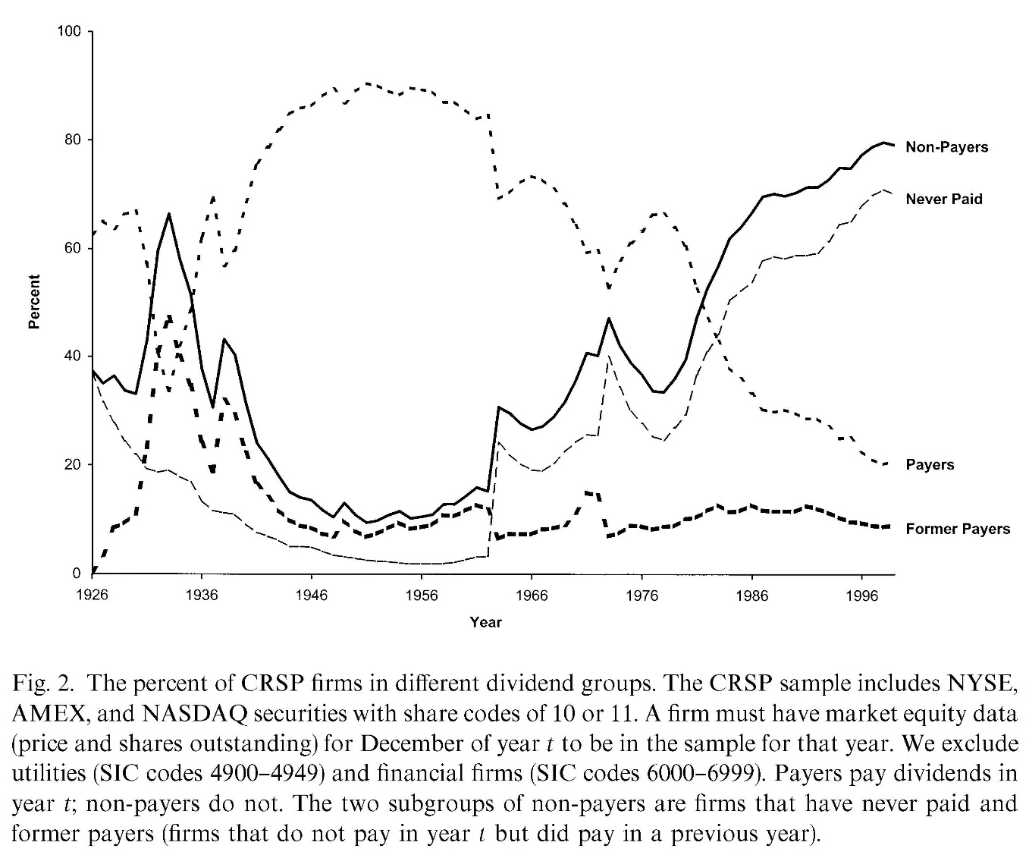
Declining dividends

Slide 8
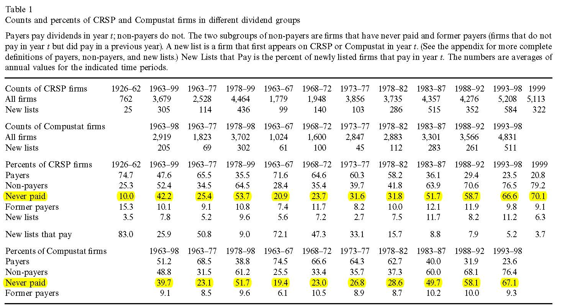
Percent of firms

Slide 9
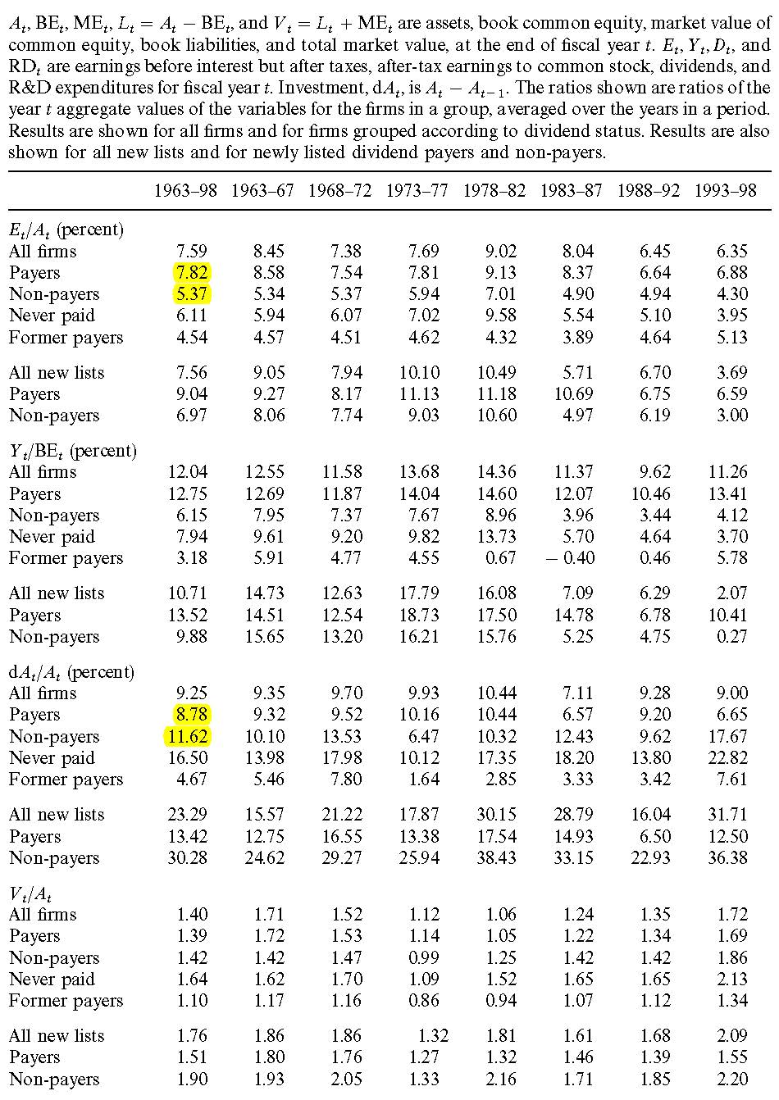

Slide 10
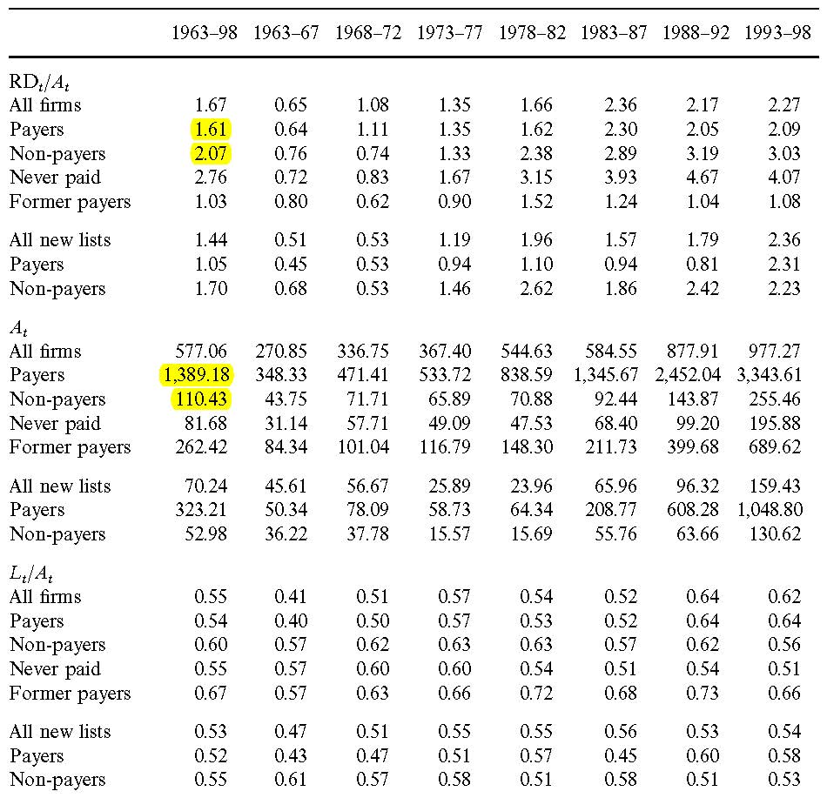

Slide 11
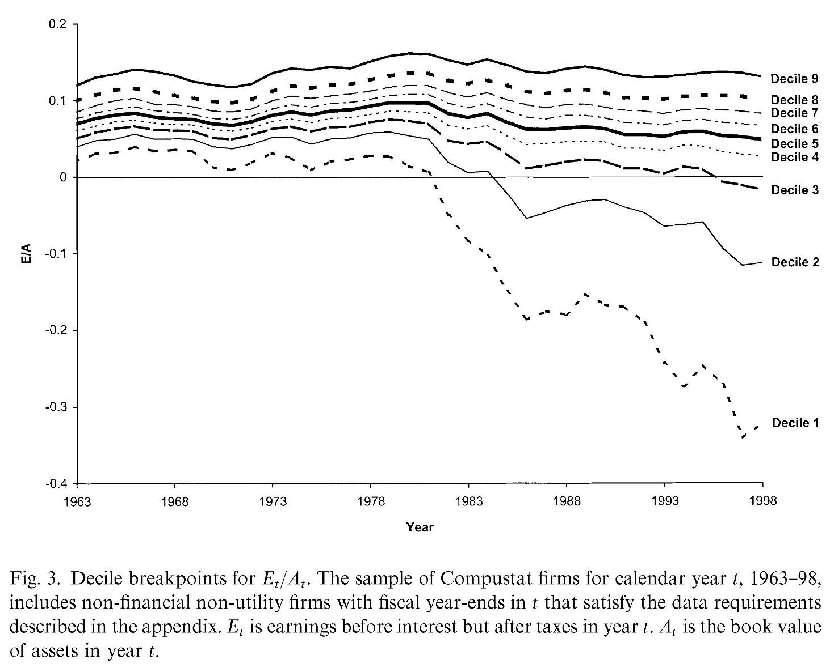
Earnings performance

Slide 12
Characteristics of dividend payers
Dividend payers tend to be large, profitable firms with earnings and investment outlays
Firms that have never paid are smaller and less profitable than dividend payers, but they have more investment opportunities and their investment outlays are much larger than their earnings
Former payers have low earnings and few investments

Slide 13
New lists and dividends
The steady decline in the percent of firms paying dividends is in part due to an increasing tilt of the public firms toward the characteristics typical of firms that have never paid.
The source of the tilt is new lists. There is a surge in newly listed firms after 1977, and they differ from earlier new lists.
During the early years of the 1963-98 period, new lists tend to be small, profitable firms with abundant investments.
After 1977, new lists continue to be small and to grow rapidly. But their profitability deteriorates, and new lists that pay dividends become increasingly rare.

Slide 14
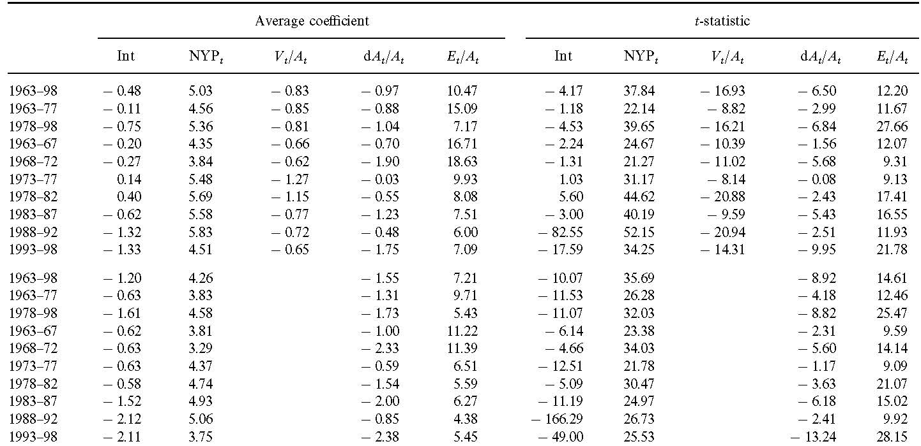
Logit regressions Fama-MacBeth approach

Slide 15
Propensity to pay dividends
If changing characteristics drive the dividend trend, firms with particular characteristics should be as likely to pay now as in the past
But Figure 6 suggests that dividends become less likely among firms with the characteristics (positive earnings and earnings in excess of investment) of dividend payers
Even unprofitable firms and firms with investment outlays that exceed earnings also become less likely to pay

Slide 16
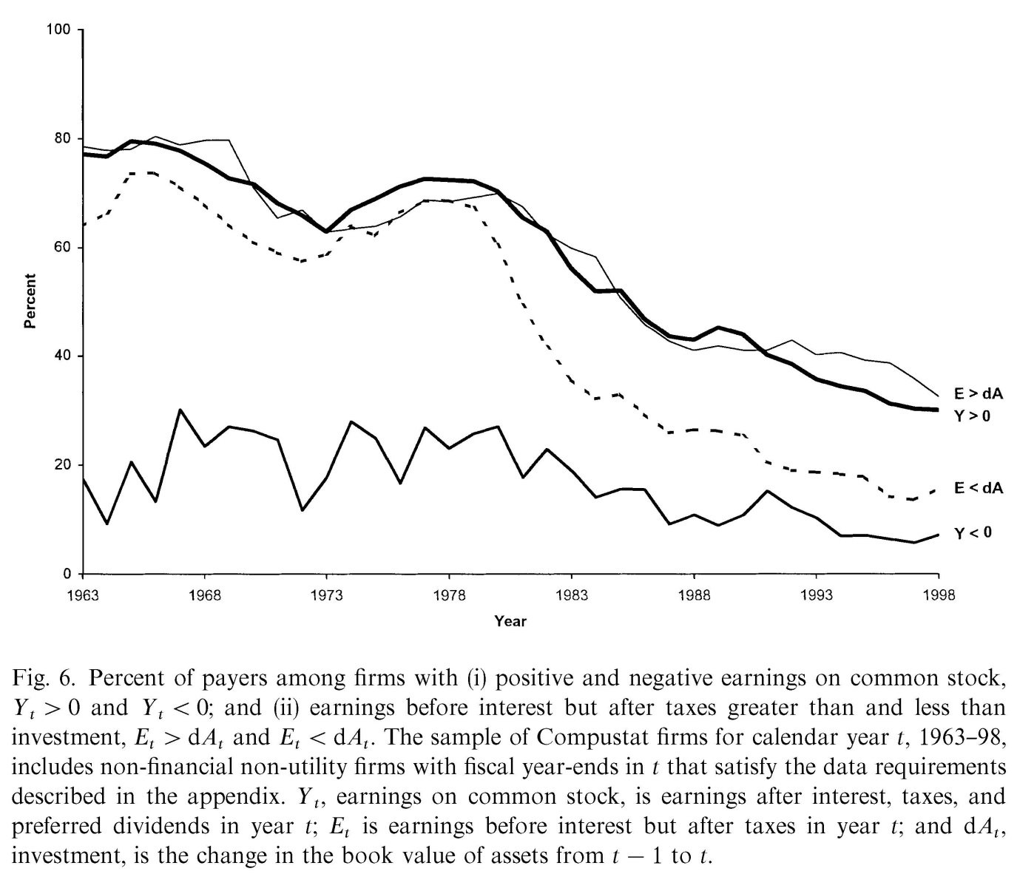
Percent of payers

Slide 17
Measure the propensity to pay
First estimate the probabilities that firms with given characteristics (size, profitability, and investment opportunities) pay dividends during 1963-77.
Then apply the probabilities from 1963-77 to the samples in subsequent years to estimate the expected percent of dividend payers for each year after 1977
Since the probabilities associated with characteristics are fixed at their base period values, variation in the expected percent of payers after 1977 is due to changing characteristics
The difference between the expected percent and the actual percent is to measure the change in the propensity to pay dividends (the higher the diff, the lower the propensity)

Slide 18
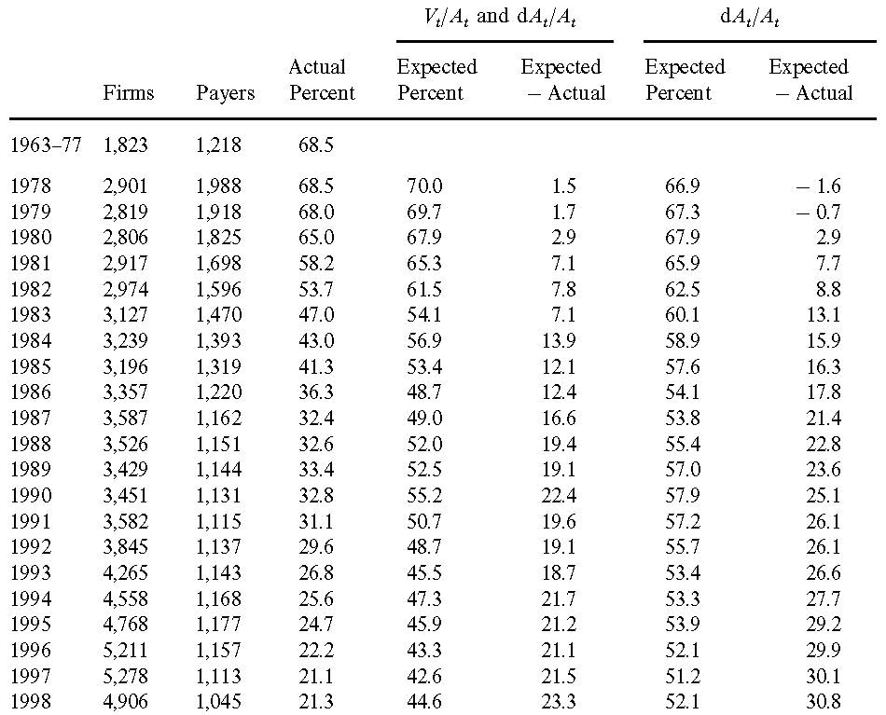
Separate the propensity to pay from changing characteristics

Slide 19
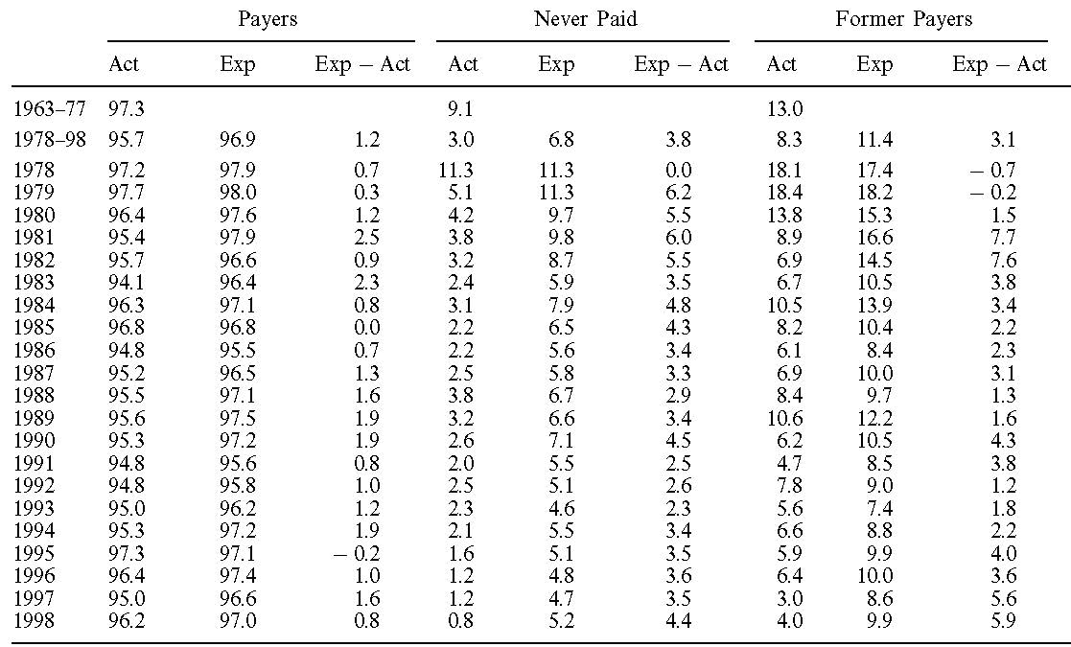
Effects on three dividend groups

Slide 20
Effects on non-payers
The characteristics of dividend payers do not change much through time. In all but one year of the 1978-98 period, the actual percent of continuing payers falls short of the expected
Changing characteristics and lower propensity to pay have bigger effects on former payers.
The effects are also strong on firms that have never paid. Controlling for characteristics, firms that have never paid dividends become less likely to start.

Slide 21
Conclusion: Fama & French (2001)
The percent of firms paying dividends declines sharply after 1978
Larger firms and more profitable firms are more likely to pay dividends. Dividends are less likely for firms with more investments.
The decline after 1978 is due in part to an increasing tilt of public firms toward the characteristics of firms that have never paid - low earnings, strong investments, and small size.
This tilt in the population of firms is driven by an explosion of newly listed firms, and by the changing nature of the new firms.

Slide 22
Conclusion: Fama & French (2001)
Lower propensity to pay is at least as important as changing characteristics in explaining the decline in the percent of dividend payers.
Changing characteristics and lower propensity to pay show up more clearly in the dividend decisions of former payers and firms that have never paid
As repurchases are largely the province of dividend payers, they leave the decline in the percent of payers largely unexplained.

Slide 23
Why dividends disappear?
Perceived benefits of dividends have declined through time.
Some (but surely not all) of the possibilities are:
lower transactions costs for selling stocks for consumption purposes, in part due to an increased tendency to hold stocks via open end mutual funds;
larger holdings of stock options by managers who prefer capital gains to dividends;
better corporate governance technologies (e.g., more prevalent use of stock options) that lower the benefits of dividends in controlling agency problems between stockholders and managers

Slide 24
Are dividends disappearing? Dividend concentration and the consolidation of earnings
DeAngelo, DeAngelo, Skinner, JFE 2004

Slide 25
Are dividends disappearing?
Total dollar dividends paid by industrial firms actually increased over 1978–2000
Why did aggregate dividends increase despite a 50% decline in the number of payers?
the reduction in payers occurs almost entirely among firms that paid very small dividends
increased real dividends from the top payers swamp the modest dividend reduction from the loss of many small payers.

Slide 26
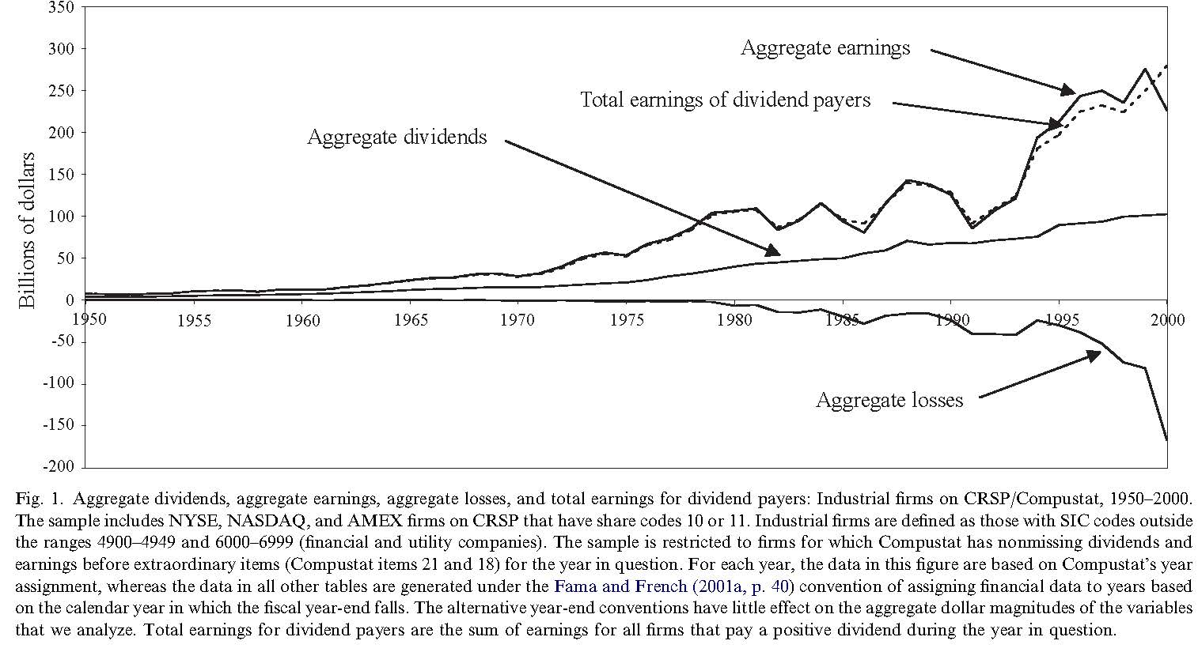
Aggregate dividends increase

Slide 27
Dividends become concentrated
Dividends have become increasingly concentrated among a small number of profitable firms
reflects high and increasing earnings concentration
the top 25 dividend paying firms typically pay more than 50% of aggregate dividends
These firms also constitute more than 50% of aggregate industrial earnings

Slide 28
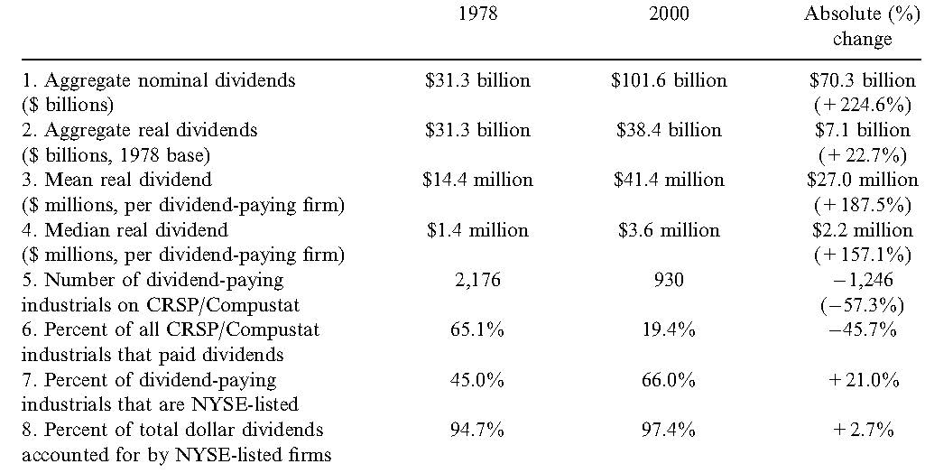
Dividend concentration

Slide 29
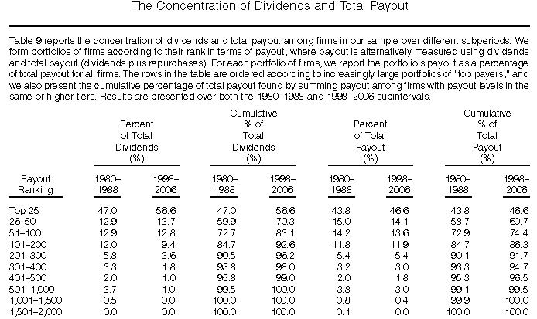
Has propensity to pay out declined?
Grullon, Paye, Underwood, Weston, 2011, JFQA

Slide 30
Dividend policy and the earned/contributed capital mix: A test of the life-cycle theory
DeAngelo, DeAngelo, and Stulz, JFE 2006

Slide 31
Dividend life cycle theory
Dividends tend to be paid by mature, established firms, plausibly reflecting a financial life cycle
young firms face relatively abundant investment opportunities with limited resources so that retention dominates distribution
mature firms are better candidates to pay dividends because they have higher profitability and fewer attractive investment opportunities

Slide 32
Testing life cycle theory
Test whether the probability a firm pays dividends is positively related to its mix of earned and contributed capital? i.e.,
Test whether firms with relatively high retained earnings as a proportion of total equity (RE/TE) and of total assets (RE/TA) are more likely to pay dividends?
RE: earned equity
TE – RE: contributed equity

Slide 33
Why earned/contributed mix?
The earned/contributed capital mix is a logical proxy for the life-cycle stage because it measures the extent to which the firm is self-financing or reliant on external capital.
Firms with low RE/TE (RE/TA) tend to be in the capital infusion stage.
Firms with high RE/TE (RE/TA) tend to be more mature with ample cumulative profits. These firms tend to be largely self-financing and thus good candidates to pay dividends.
It is a better measure of a firm’s life-cycle stage (hence suitability to pay dividends) than its cash balances, because the source of the cash affects the dividend decision.

Slide 34
Dividends and earned equity
Probability a firm pays dividends increases with the relative amount of earned equity in its capital structure
the proportion of firms that pay dividends is high when the ratio of earned to total common equity (RE/TE) is high and falls with declines in this ratio, reaching near-zero levels for firms with negligible retained earnings
Similar results for RE/TA (earned equity to total assets)
There is no such monotonic relation between the proportion of firms that pay dividends and TE/TA, indicating that a firm’s earned/contributed capital mix (and not its total equity relative to other sources of capital) is a key determinant of its decision to pay or not pay dividends

Slide 35
Effect of life cycle
Our RE/TE and RE/TA measures have a stronger impact on the decision to pay dividends than do profitability and growth.
The impact of firm size differences on the probability of paying dividends is also substantial, while profitability and growth differences have a relatively modest impact

Slide 36
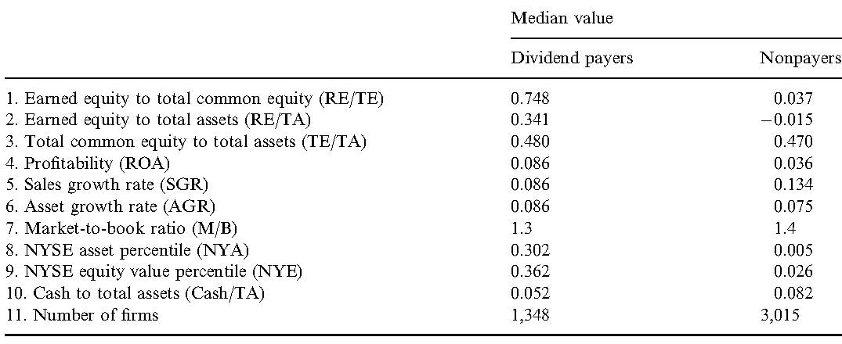
Payers vs. nonpayers

Slide 37
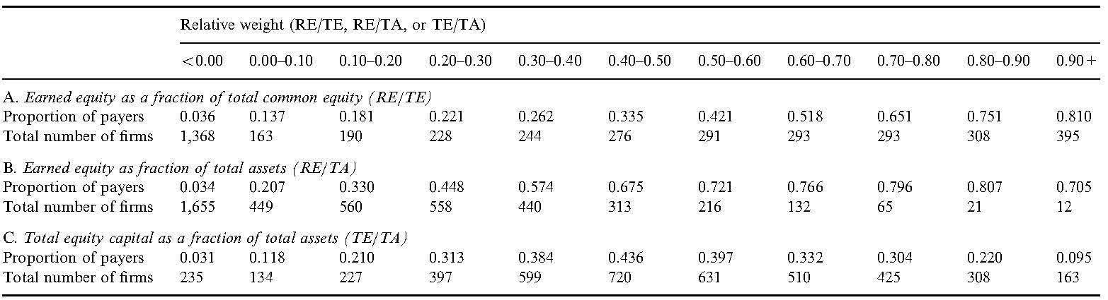
Earned equity and dividends

Slide 38
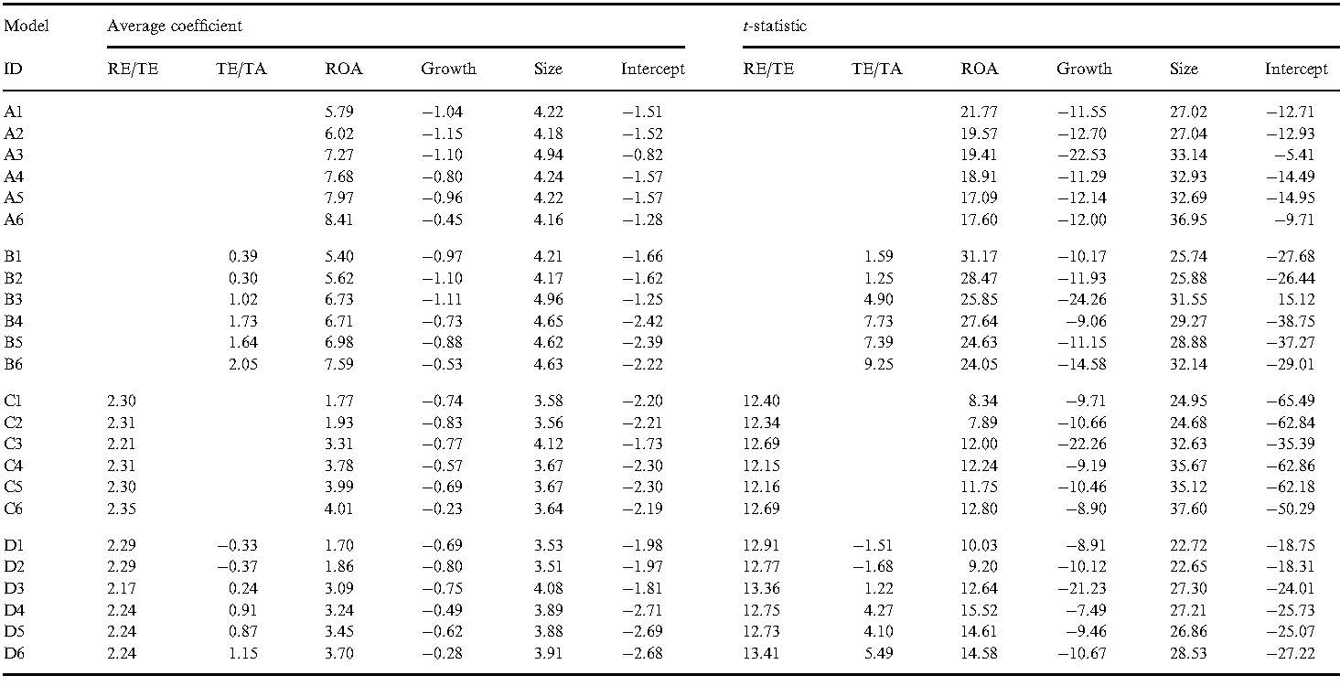
Logit regressions Fama-MacBeth approach

Slide 39
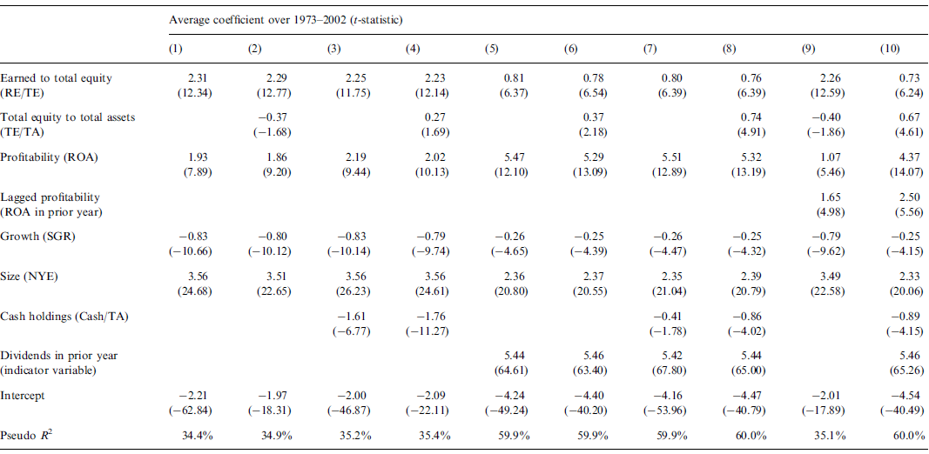
Logit regressions of dividends
Benartzi et al (1997) report evidence that dividend changes convey information about profitability in the year before.
Larger cash holdings could indicate accumulative of excess funds or of resources to fund an abundance of new investments.
The lagged dividend status is a strong predictor of whether to pay dividends this year.

Slide 40
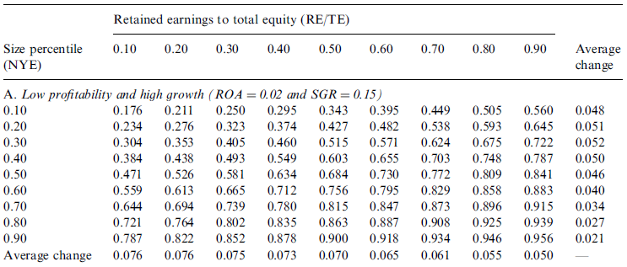
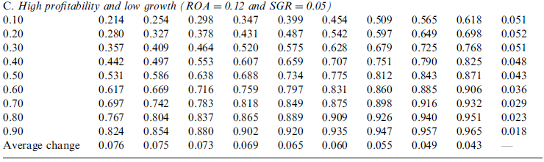
Impact of profitability and growth
0.734－0.684=0.05

Slide 41
Marginal effect on dividends
quantitative impact of variation in profitability and growth is relatively modest
In contrast, size differences are associated with substantial differences in the probability of paying dividends
RE/TE differences are associated with substantial differences in the probability of paying dividends for all but the highest size deciles of NYSE firms
impact of both RE/TE and size is much greater than the impact of profitability and growth

Slide 42
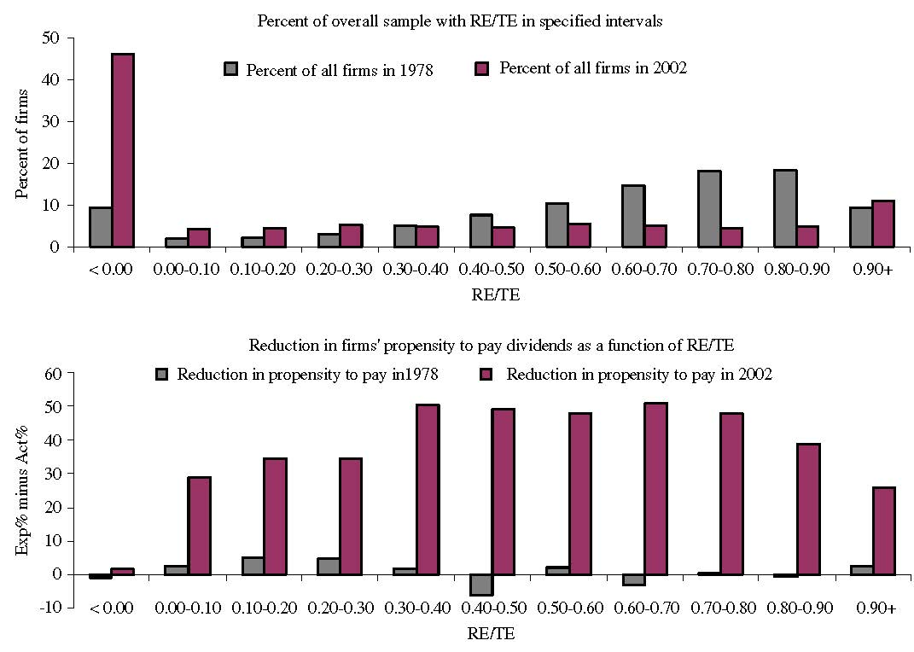
Reduction in propensity to pay

Slide 43
Disappearing dividend puzzle
Firms with positive RE/TE are both natural candidates to pay dividends and exhibit reductions in the propensity to pay that commonly reach 50.0%, the ‘‘disappearing dividends’’ puzzle is an even greater mystery than indicated by Fama and French’s estimates, which do not control for the earned/contributed capital mix
Future research needs to focus on explaining the sharp reduction in the propensity to pay dividends by firms whose earned/contributed capital mix implies they are likely in the distribution stage of their financial life cycle.
No anomalous propensity to pay reduction among the roughly half industrial firms with negative retained earnings

Slide 44
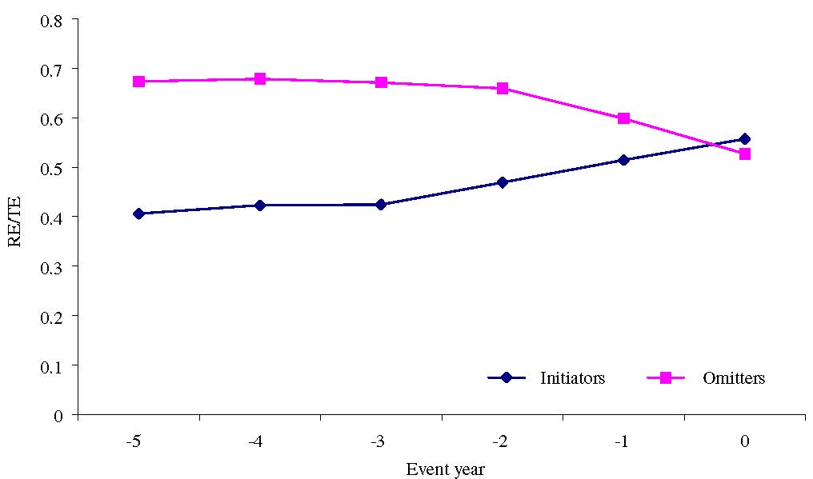
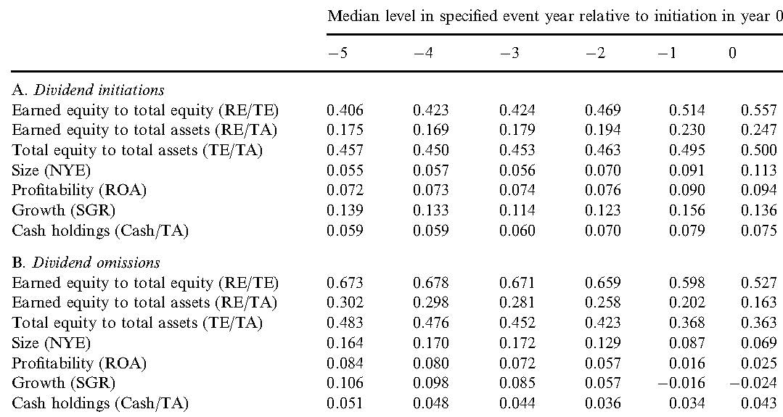
Dividend initiations and omissions

Slide 45
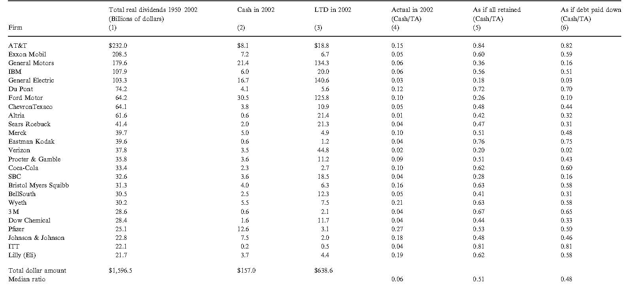
Dividends of 25 large firms

Slide 46
Retention versus distribution in the life-cycle
If these 25 large firms had not paid dividends, they would have huge cash balances and little or no long-term obligations — the characteristic of rapidly growing firms in industries with massive technological change, and not of mature companies in stable industries
These results are difficult to explain by non-life cycle theories such as signaling and catering
In our view, the agency cost-inclusive life-cycle theory most powerfully explains the dividend decisions of the 25 largest longstanding dividend payers because of their choice to distribute substantial dividends consistently over long horizons

Slide 47
Conclusion: DDS (2006)
we consistently observe a highly significant relation between the decision to pay dividends and RE/TE (and RE/TA), controlling for firm size, current and recent profitability, growth, total equity, cash balances, and dividend history, a relation that also holds for dividend initiations and omissions.
Our RE/TE and RE/TA measures have a stronger impact on the decision to pay dividends than do profitability and growth

Slide 48
Conclusion: DDS (2006)
While a massive increase in firms with negative retained earnings (from 11.8% in 1978 to 50.2% in 2002),we find that firms with negative retained earnings show virtually no change in their propensity to pay dividends
Firms that earned equity and are reasonable candidates to pay dividends have a propensity reduction that is twice the overall reduction estimated by Fama and French.
All our evidence supports a life-cycle theory of dividends, in which a firm’s stage in that cycle is well captured by its mix of internal and external capital, so that dividend payers tend to have high earned equity relative to contributed capital, and nonpayers the reverse.

Slide 49
Denis and Osobov (2008)
Extend the literature by examining the propensity to pay dividends in developed markets (US, Canada, UK, Germany, France, and Japan) over the period 1989–2002.
Examine whether characteristics of dividend payers and nonpayers are common across countries, whether these characteristics have changed over time, and whether firms exhibit a declining propensity to pay dividends recently.
The use of international data provides further tests of the life cycle, signaling, clientele, and catering explanations by analyzing the concentration of dividend payments as well as the association between the Baker and Wurgler (2004a, b) dividend premium and the propensity to pay dividends.

Slide 50
International evidence on the determinants of dividend policy
The propensity to pay dividends is higher among larger, more profitable firms, and those for which retained earnings comprise a large fraction of total equity.
Although there are hints of reductions in the propensity to pay dividends in most of the sample countries over the 1994–2002 period, they are driven by a failure of newly listed firms to initiate dividends when expected to do so.
Dividend abandonment and the failure to initiate by existing nonpayers are economically unimportant except in Japan.

Slide 51
International evidence on the determinants of dividend policy
In each country, aggregate dividends have not declined and are concentrated among the largest, most profitable firms.
Finally, outside of the US there is little evidence of a systematic positive relation between relative prices of dividend paying and non-paying firms and the propensity to pay dividends.
Overall, these findings cast doubt on signaling, clientele, and catering explanations for dividends, but support agency cost-based lifecycle theories.

Slide 52
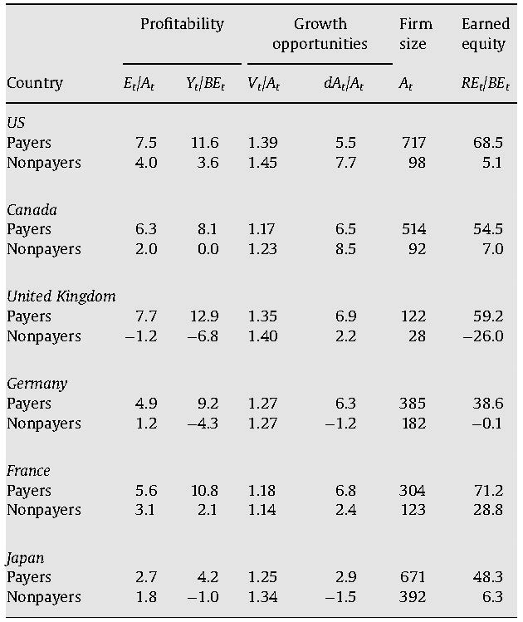
Payers vs. nonpayers

Slide 53
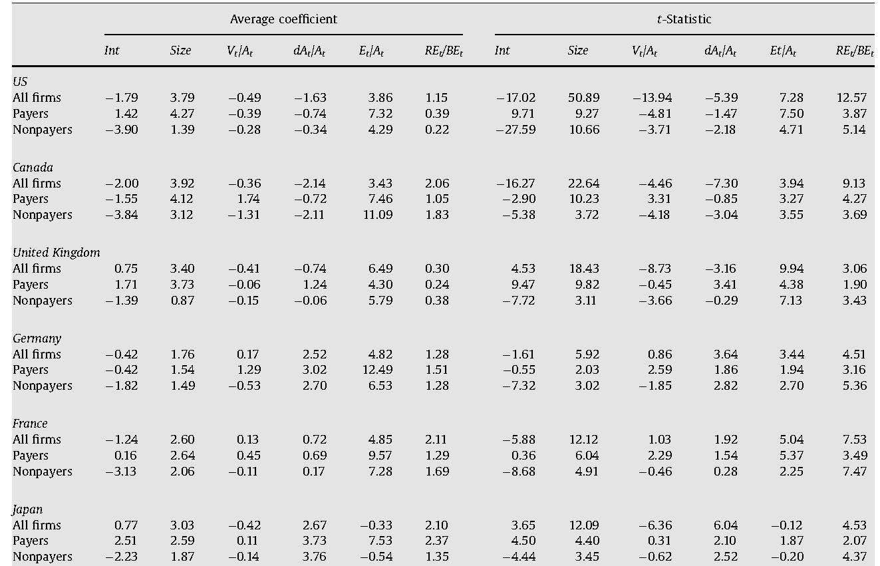
Logit regressions of dividends

Slide 54
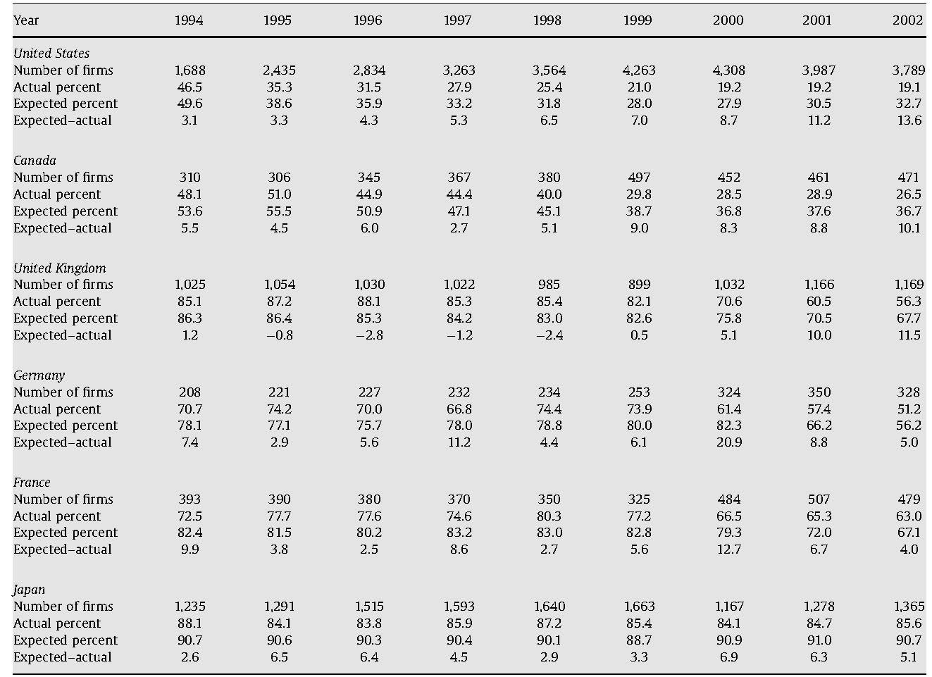
Reductions in propensity to pay

Slide 55
von Eije and Megginson (2008)
We examine cash dividends and repurchases from 1989 to 2005 in the 15 European nations.
As in the United States, the fraction of European firms paying dividends declines. Total real dividends paid increase and share repurchases surge.
Our regression analyses indicate that increasing fractions of retained earnings to equity do not increase the likelihood of cash payouts, whereas company age does.

Slide 56
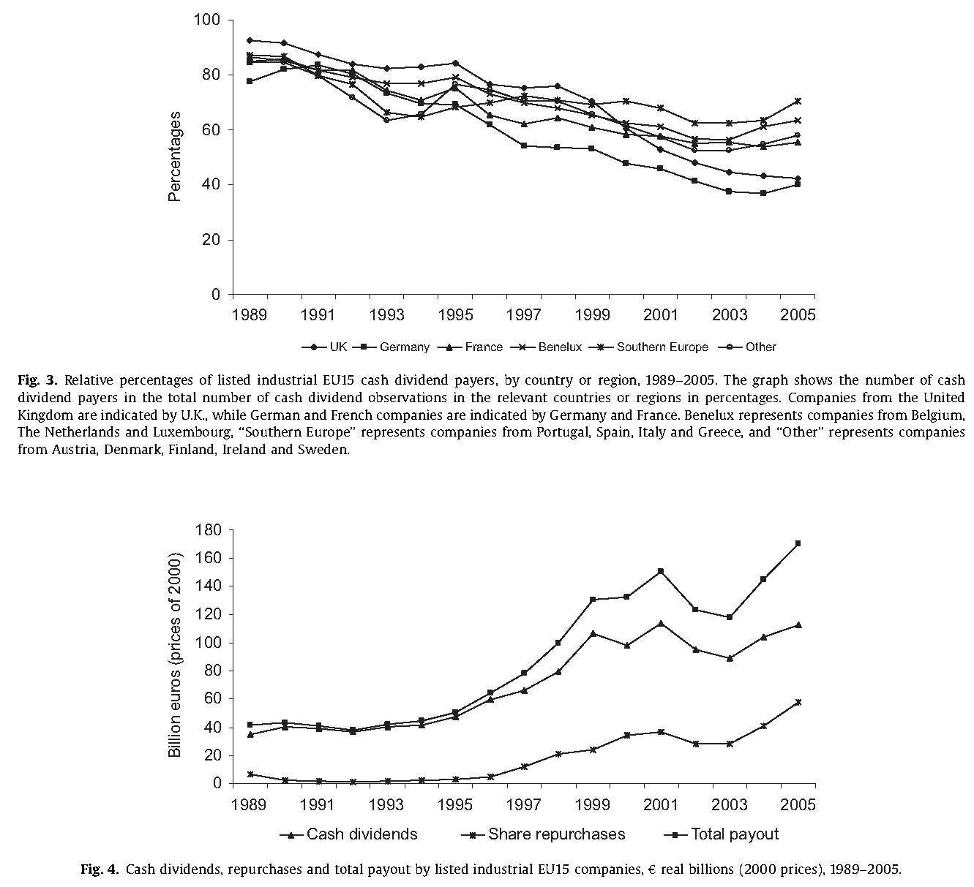

Slide 57
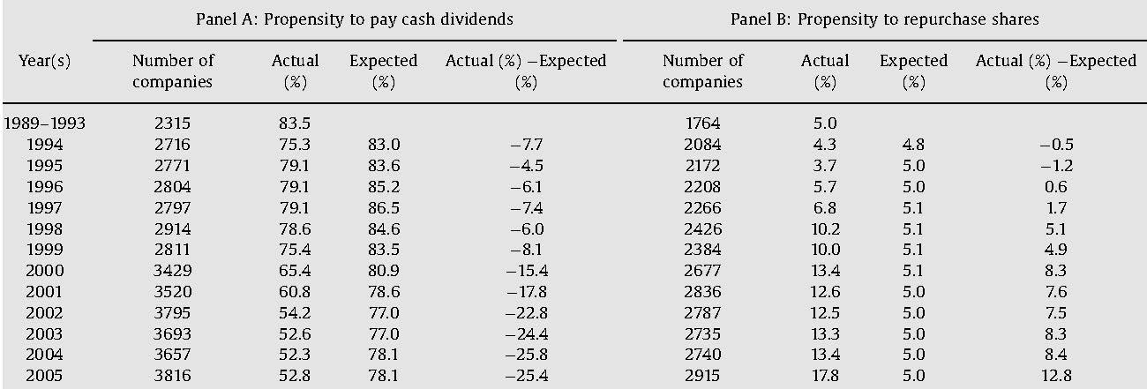
European propensity to pay out

Slide 58
Post-FF (2001)
Overall, the available international evidence is consistent with the findings of DeAngelo et al. (2004) on US firms - aggregate real dividends have increased in recent years, despite a decline in the proportion of industrial firms that pay dividends
one plausible explanation for the observed reduction in firms’ propensity to pay dividends is that an especially high degree of earnings volatility in recent years has made younger firms more reluctant to initiate dividends than they were in prior years

Slide 59
Why do firms repurchase stock?
Dittmar, JB 2000

Slide 60
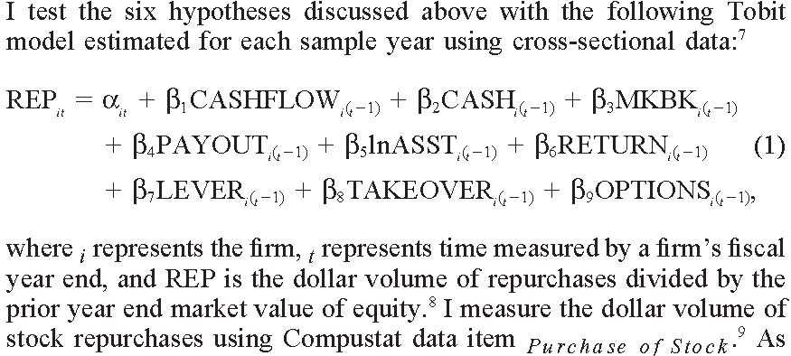
Dittmar (2000)

Slide 61
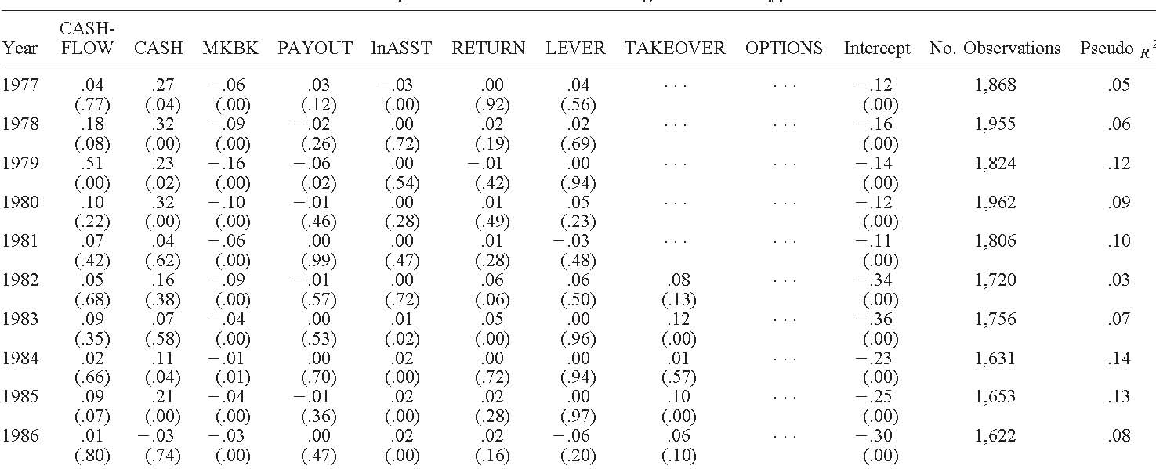
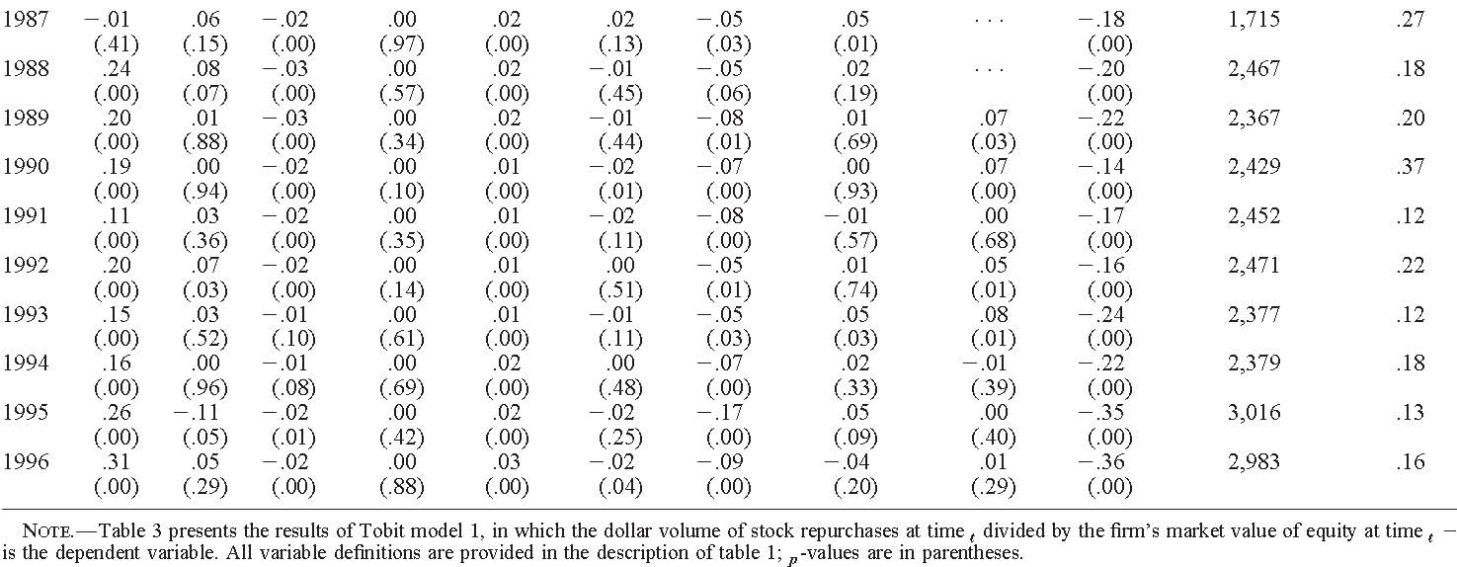

Slide 62
Motivations for Repurchases
Signaling (ILV, JFE 1995)
Free cash flow (GM, JF 2004)
Capital structure adjustment (HOT, JB 2001)
Substitution for cash dividends (GM, JF2002)
Wealth transfer (MS, JF 2003)
Takeover defense (BX, JF 2007)
Employee stock options (Kahle, JFE 2002)
EPS increase (HJJ, JAE 2006)

Slide 63
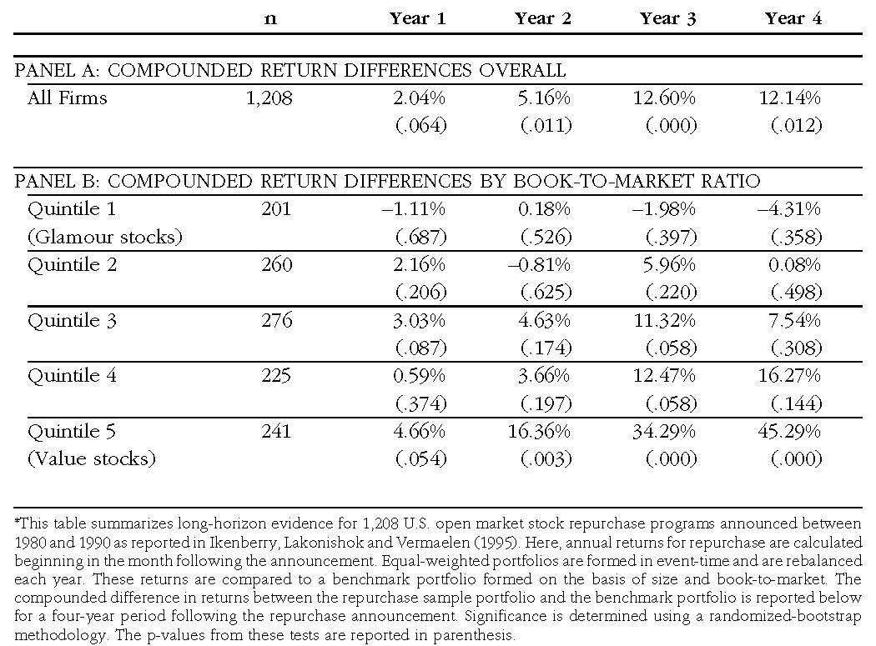
Undervaluation

Slide 64
The information content of share repurchase programs
Grullon and Michaely, JF 2004

Slide 65
Economic motivations behind buyback
Two major reasons for repurchasing shares are analyzed in the theoretical literature.
The first is to signal better prospects (Signaling)
Bhattacharya (1979), Miller and Rock (1985), Vermaelen (1984)
These papers suggest that repurchases can be used as a costly signal about future cash flows
The second is to reduce free cash flows at management’s disposal. (Free cash flow)
Firms repurchase their shares to mitigate potential over-investment by management (Jensen (1986)).
Firms that have been experiencing a reduction in growth opportunities and profitability will be more likely to repurchase

Slide 66
Predictions under signaling
Repurchase announcements should be
associated with positive price changes
Prior research documents a positive market reaction
followed by positive news of profitability
Operating performance improves?
followed by positive changes in the market’s expectation about future profitability
Upward earnings forecast revisions by analysts?

Slide 67
Predictions under free cash flow
When a firm slows down, its economic profit declines.
ROA would decline
In this phase, capital expenditures decline, and the firm generates larger amounts of free cash flows.
Reduction in investments and cash
When a firm has fewer options to grow and assets in place play a bigger role in determining its value, the firm’s systematic risk declines.
Lower systematic risk and lower cost of capital

Slide 68
No support for signaling
We find no evidence that repurchasing firms experience an improvement in future profitability relative to their peer firms. In fact, some of the performance measures indicate that repurchasing firms underperform their peers.
We also find that analysts revise their expectations downward after the announcement of a share repurchase program.

Slide 69
Support for free cash flow story
Repurchasing firms reduce their current level of capital expenditures and research and development (R&D) expenses.
The level of cash reserves on their balance sheets significantly declines.
Finally, we find that the market reaction to share repurchase announcements is stronger among those firms that are more likely to overinvest.
These findings, combined with the evidence on profitability, indicate that firms increase their cash payouts in response to a deterioration in their investment opportunity set.

Slide 70
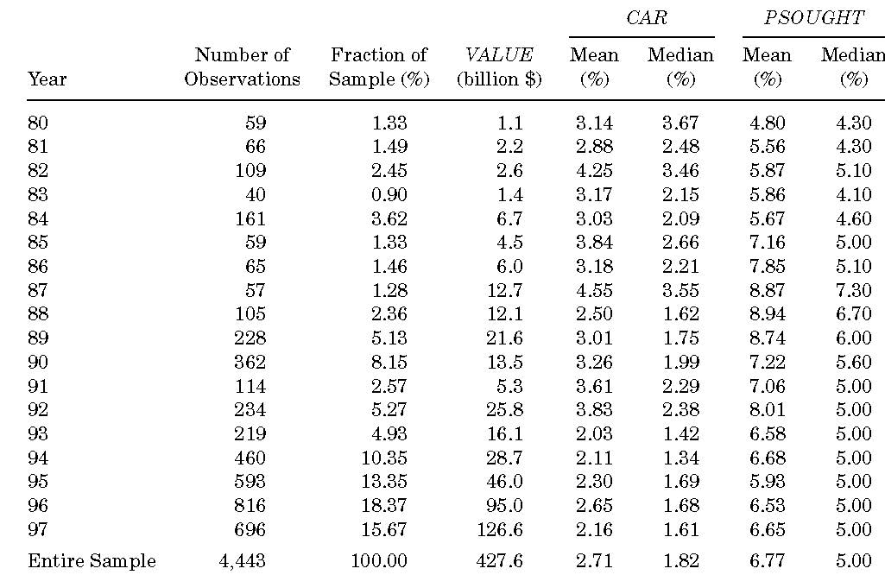
Repurchase sample

Slide 71
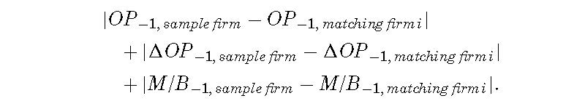
Detect abnormal earnings
To examine the post-event performance of repurchasing firms relative to their pre-event performance, we examine the changes in operating performance.
Barber and Lyon (1996) recommend the use of changes instead of levels because the test statistics based on changes are more powerful than those based on levels.
Lie (2001) shows that the performance-adjusted benchmark yields more powerful test statistics than do other benchmarks
Matching firms are selected by minimizing the following
71

Slide 72
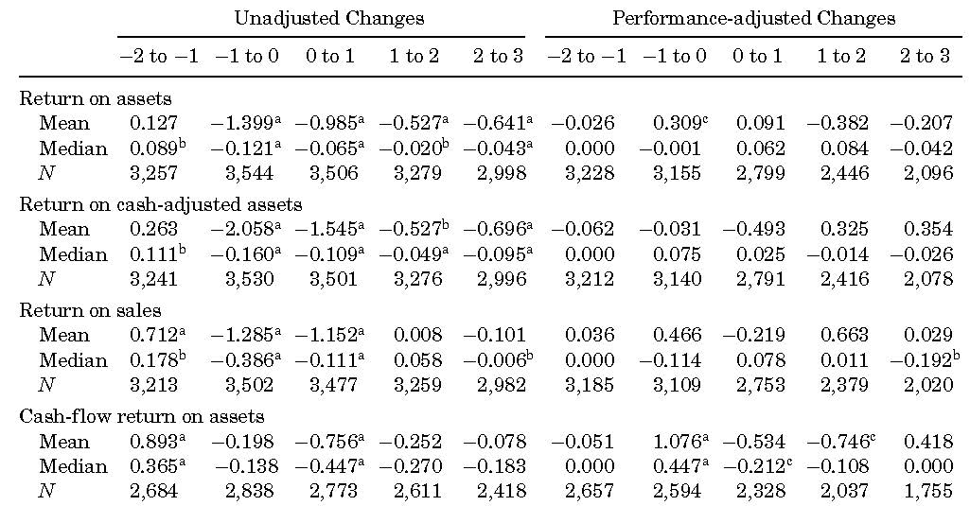
Operating performance

Slide 73
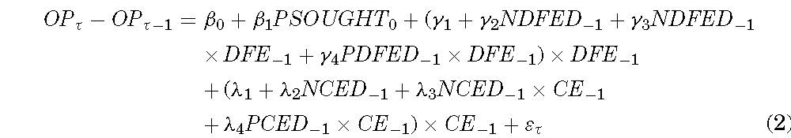
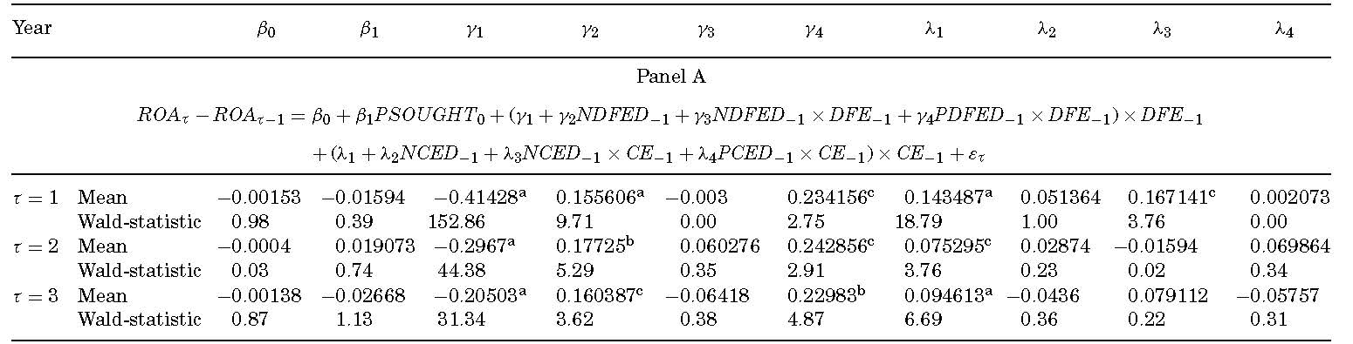
Larger buybacks do not have better performance

Slide 74
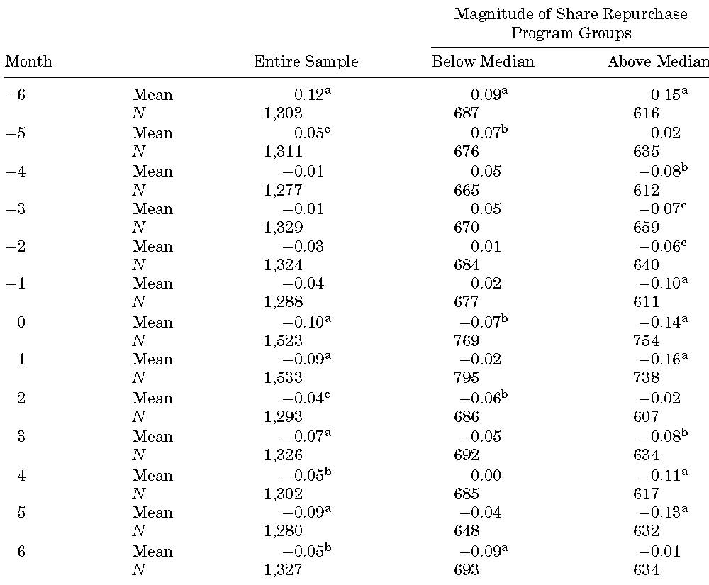
Analysts’ Forecast Revisions

Slide 75
Reject the signaling hypothesis
Overall, the results in operating performance do not support the idea that share repurchases are followed by improvements in profitability or operating performance.
Nor does the evidence suggest that the market revises its expectation of earnings upward following repurchase announcements.

Slide 76
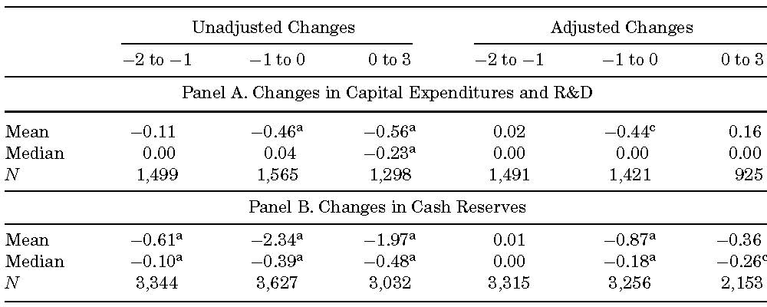
Changes in Capital Expenditures, R&D, and Cash Reserves

Slide 77
Reduction in investment and cash
Repurchasing firms reduce their capital expenditures and R&D during the year of the event (−1 to 0) and the 3 years after the event (0 to 3)
Repurchasing firms significantly reduce their cash reserves following these announcements, supporting that repurchasing firms face a shrinking investment opportunity set
These results are consistent with notion that these firms have been experiencing a contraction in their investment opportunity set and firms repurchase shares to reduce excess cash.

Slide 78
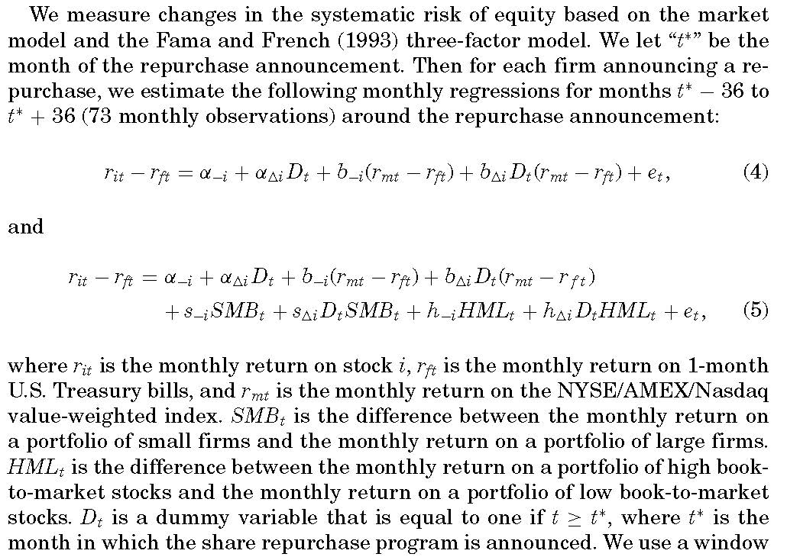
Change in systematic risk

Slide 79
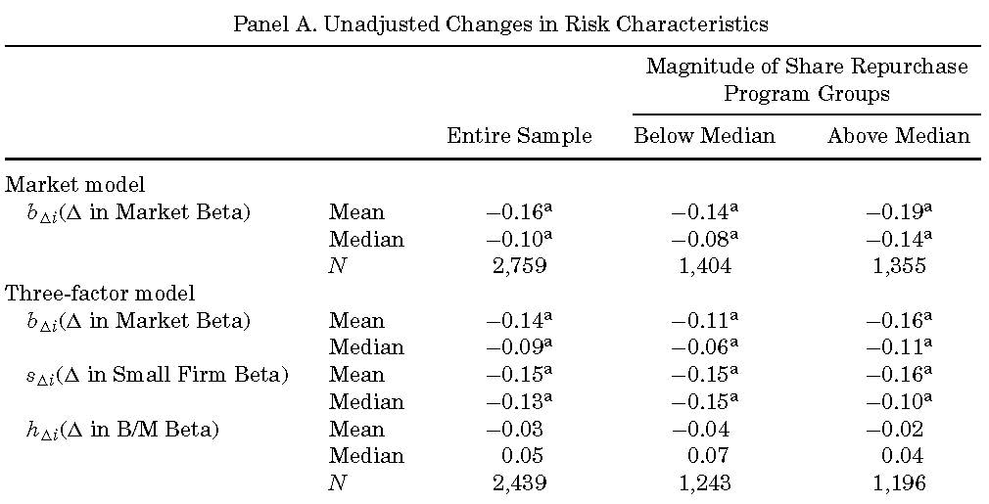
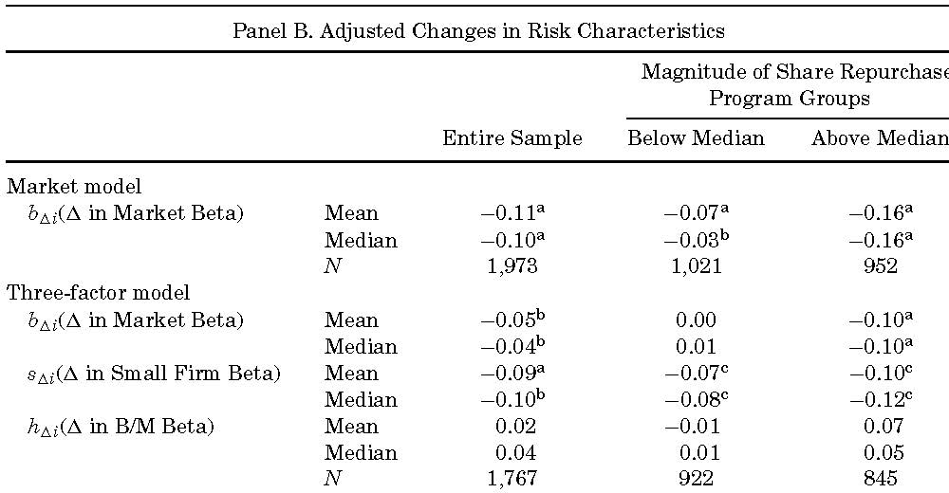

Slide 80
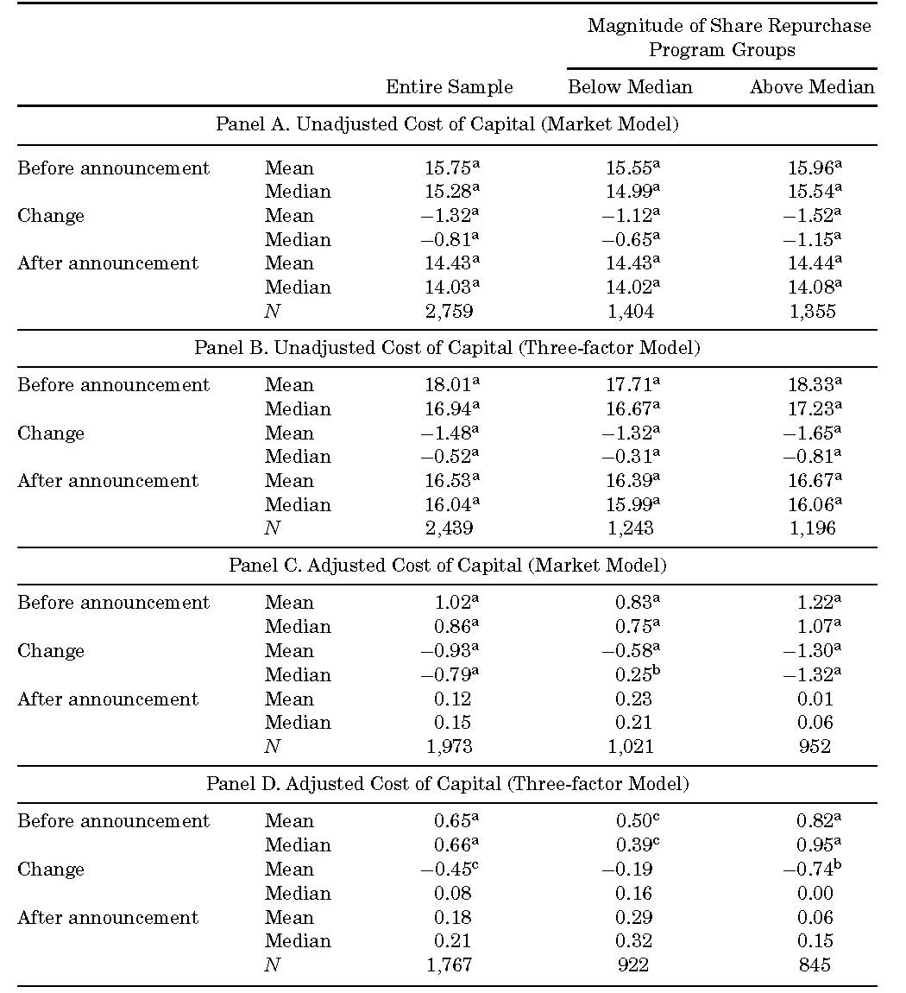

Slide 81
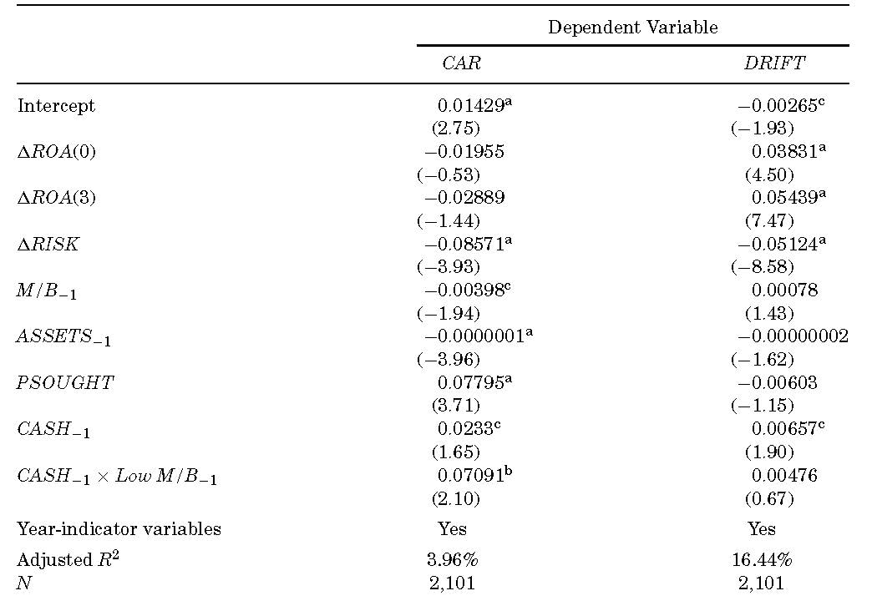
Market reactions to changes in profitability and risk
These firms are more likely to overinvest

Slide 82
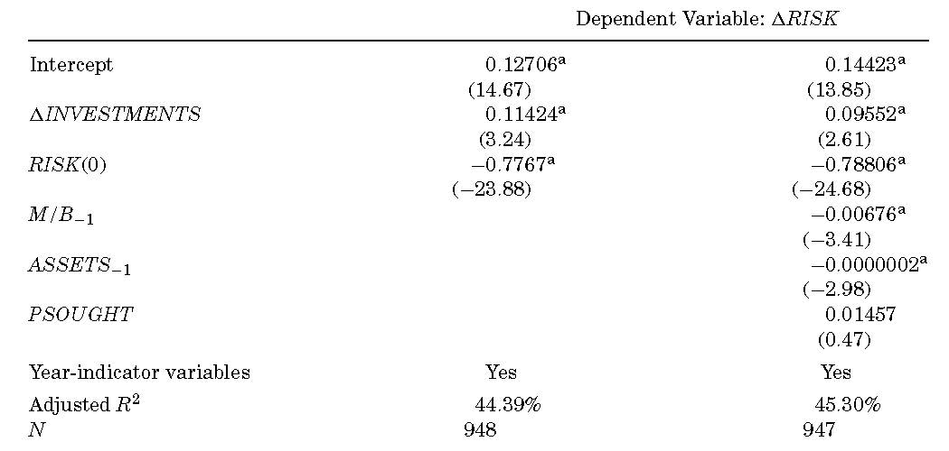
Impact of changes in investments on cost of capital

Slide 83
Conclusion: GM (2004)
We test whether the information content of repurchases is about growth in future earnings (and other profitability measures), or whether it is related to a reduction in agency conflicts
We cannot find any evidence that repurchasing firms experience a growth in profitability.
Our evidence suggests that the reduction in free cash flows and systematic risk are sources of the positive market reaction to the repurchase announcement.
We also find that the market reaction to share repurchase announcements is stronger among those firms that are more likely to overinvest.

Slide 84
Conclusion: GM (2004)
Overall, when we combine our results with the evidence concerning dividend increasing firms, it appears that repurchases and dividends are motivated by similar factors.
When future investment opportunities are contracting, an increase in cash payouts conveys important information about management commitment to reduce the agency costs of free cash flow when those costs are potentially more pronounced.
An increase in cash payouts also conveys information about changes in the risk profile and the cost of capital of the firm.

Slide 85
EPS increase in repurchases
Hribar, Jenkins, and Johnson, JAE 2006
Almeida, Fos, and Kronlund, JFE 2016

Slide 86
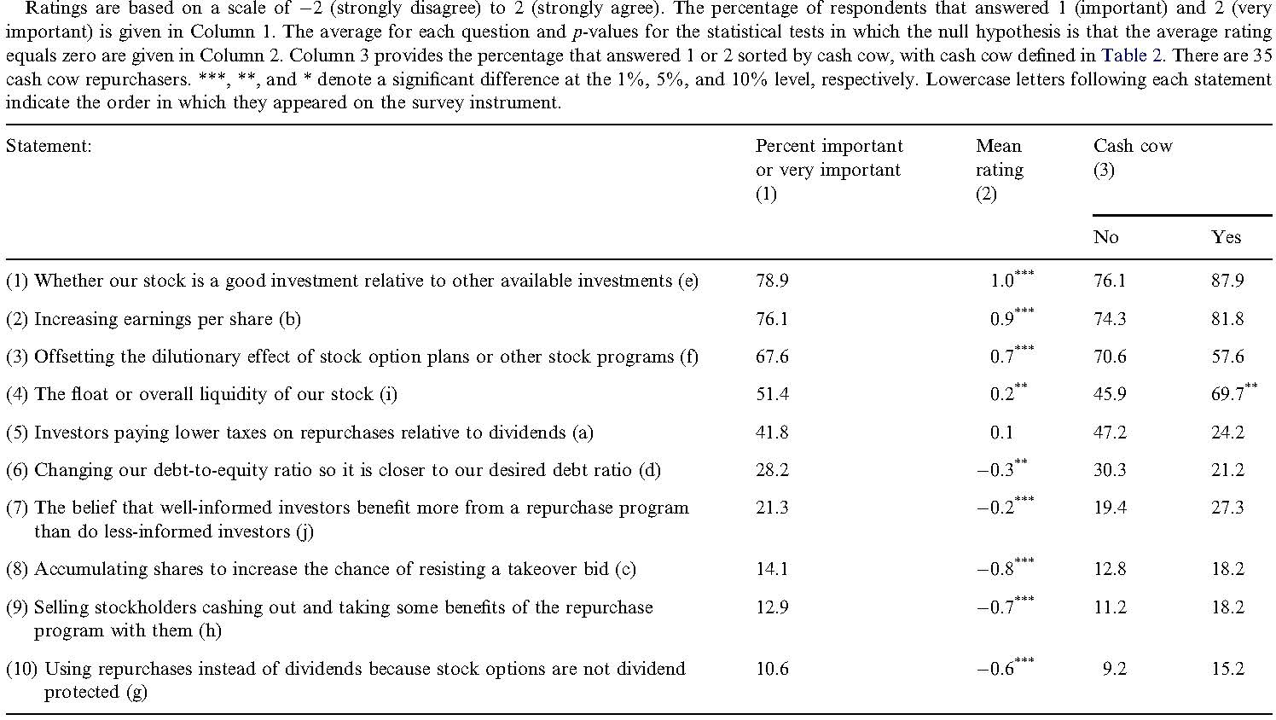
Factors of repurchase decisions
Brav, Graham, and Harvey (2005) Journal of Financial Economics

Slide 87
Stock repurchases as an earnings management device (HJJ 2006)
A disproportionately large number of accretive stock repurchases (i.e., EPS increase) among firms that would have missed analysts’ forecasts without the repurchase.
The repurchase-induced component of earnings surprises appears to be discounted by the market, and this discount is larger when the repurchase seems motivated by EPS management, although using the repurchase to avoid missing analyst forecasts appears to mitigate some of the negative stock price response.

Slide 88
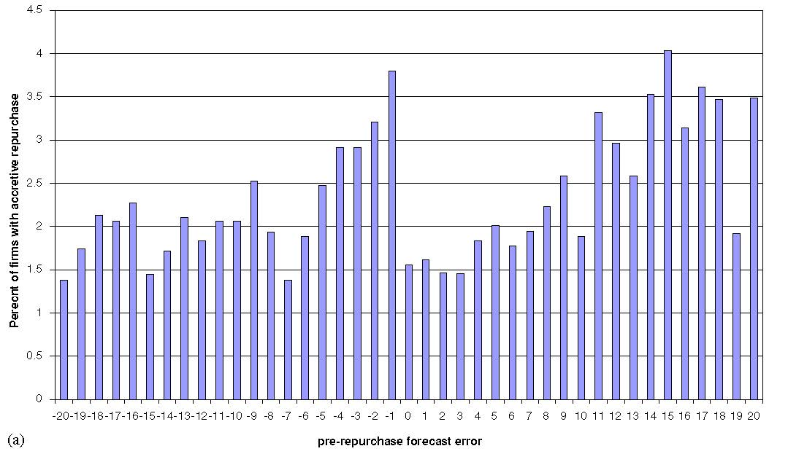
Firms miss earnings target
Accretive repurchases are disproportionately high for firms with small negative pre-repurchase quarterly EPS forecast errors

Slide 89
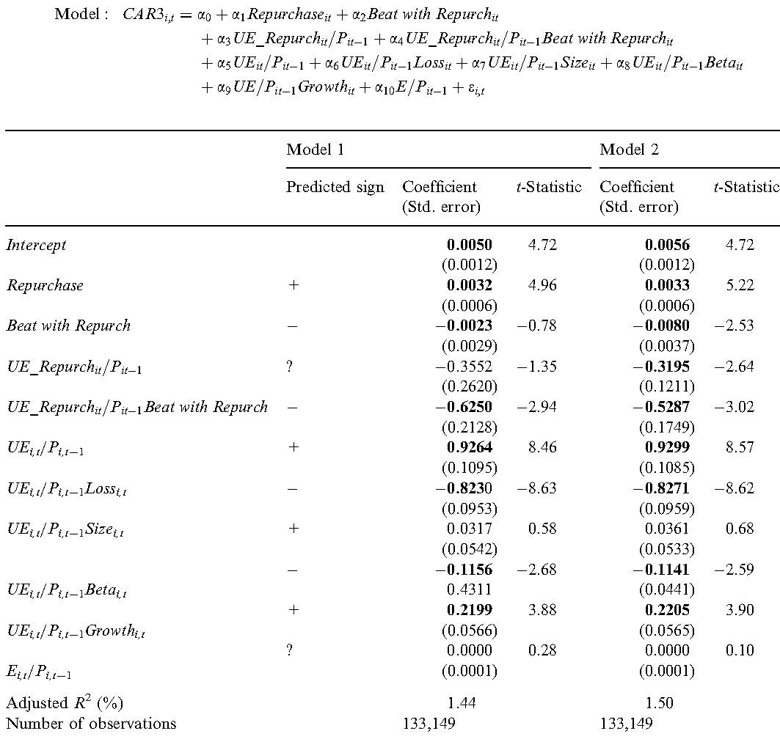
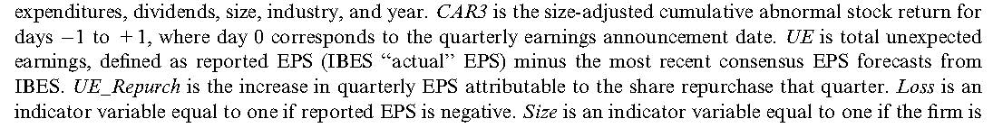
Investors discount repurchase-induced EPS increases when evaluating firms’ quarterly earnings results

Slide 90
Real effect of repurchases (AFK 2016)
Understanding consequences of share repurchases is important.
While evidence suggests that repurchases are good for firms to return cash to investors, some observers argue that the cash spent in repurchases should instead be used to increase research and employment, and that the recent increase in share repurchases is undermining both the recovery from the recent recession and the economy's long-term prospects
Prior studies suggest that firms with poor growth opportunities reduce investment and direct resources towards share repurchases
If this argument is correct, then claims that repurchases reduce economic growth are incorrect—the reductions in investment would have occurred irrespective of the amount of repurchases.
To test whether repurchases have causal effects on firm outcomes, we need to measure variation in repurchases that is not related to unobservable variation in growth opportunities

Slide 91
Regression discontinuity design
The paper exploits a discontinuity in the likelihood of share repurchases caused by earnings management (HJJ 2006).
A strong discontinuity in the probability of accretive share repurchases around the threshold at which the firm would narrowly miss the analyst earnings consensus, without conducting share repurchases.
Firms just missing EPS forecasts by a few cents absent executing a repurchase are significantly more likely to repurchase shares.
To estimate the causal effect of repurchases on investments (Capital expenditures (Capex), employment, and R&D), we regress changes in investment on share repurchases, instrumented with an indicator for whether or not a firm would announce a negative EPS surprise without a repurchase. These regressions compare firms that “just miss” the EPS consensus forecast (the treatment group) with firms that “just beat” the consensus forecast (the control group).

Slide 92
Real effect of repurchases
Firms that would have a small negative EPS surprise without repurchases tend to decrease employment, Capex, and R&D in the four quarters following increases in EPS-induced repurchases, relative to companies that just meet analyst EPS forecasts. There is a significant decrease in cash holdings, but no significant changes in debt or equity issuance.
The results support anecdotal and survey evidence that companies are willing to trade off employment and investment for stock repurchases.

Slide 93
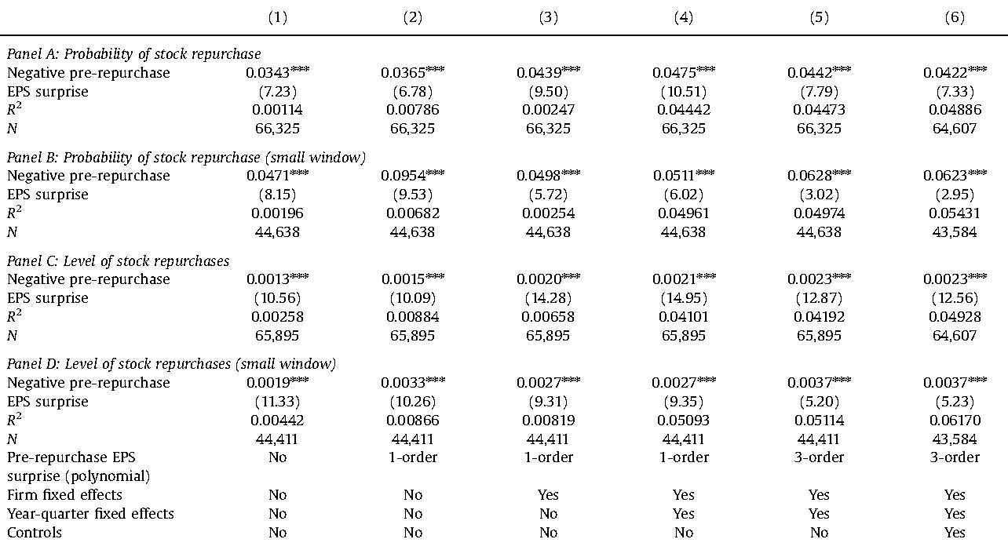
Accretive repurchases

Slide 94
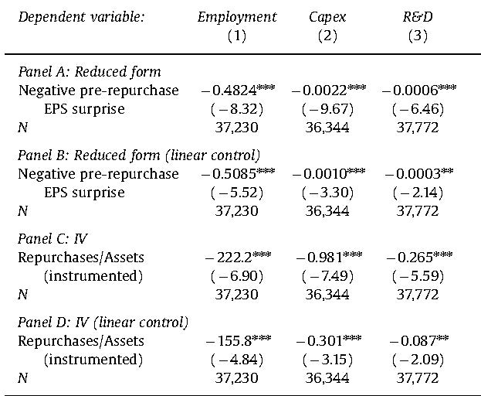
Impact of accretive repurchases

Slide 95
Real effect of repurchases
Discontinuity in repurchases is much weaker among financially constrained firms, and among firms that do not mention “EPS” or “Earnings Per Share” in their proxy statements. For these firms, there is little or no relationship between having a negative pre-repurchase EPS surprise and future employment/investment.
Financially constrained firms are less able to engage in large repurchases to manage EPS, and firms that do not mention EPS arguably care less about managing EPS.
Firms that change the sign of an earnings surprise using repurchases have similar earnings announcement returns (and ROA), compared to the firms that just meet earnings targets. However, these returns (and ROA) are lower when firms cut real variables to help finance repurchases.
While on average the trade-off between employment/investment and repurchases does not appear to be detrimental to shareholders, EPS-motivated repurchases can have more negative consequences for value and performance if they are associated with contemporaneous cuts in real investments.

Slide 96


Accretive repurchases: cross-sectional variation

Slide 97
Future research (2009 survey)
The extent to which repurchases have come to be used to distribute permanent earnings. The features of firms at which repurchases serve as a substantial, quasi-permanent payout
Relation between controlling stockholders and the payout policies of the publicly traded firms that they control
Why SEOs occur much less often than repurchases, when both seemingly allow managers to time the stock market to exploit outside investors
Whether the well-publicized disadvantage of repurchases (alienating loyal stockholders by repurchasing shares from other owners at high prices in “hot” markets) will reverse the growth of repurchases in the post-crisis period
Bridge the gap between payout policy and capital structure literatures by analyzing two decisions as interdependent

Slide 98
Future research (2014 survey)
While dividends and repurchases are not perfect substitutes, there is a non-trivial degree of substitution between the two forms of payout. But to what extent and under which circumstances do firms and the market treat dividends and share repurchases as substitutes?
How is prevalence of dividend smoothing in other countries with different ownership structures and regulatory regimes?
Mixed results in improving liquidity following repurchases
Mixed results in whether managers can time the market in executing repurchases
The interaction between payout and other corporate policies, such as compensation

